Slide 1
Webster Solar Array Monitoring
Prepared for the Town of Webster, NH
2/26/2018

Slide 2
The Webster solar array is divided into two 200-amp services
The two rows on the left as seen from the road are labeled as “North Rows” in the SolarLog monitoring system
The two rows on the right as seen from the road are labeled as “South Rows” in the SolarLog monitoring system
Each pair of rows has its own 200-amp single-phase SolarLog monitoring system
North Rows
South Rows

Slide 3
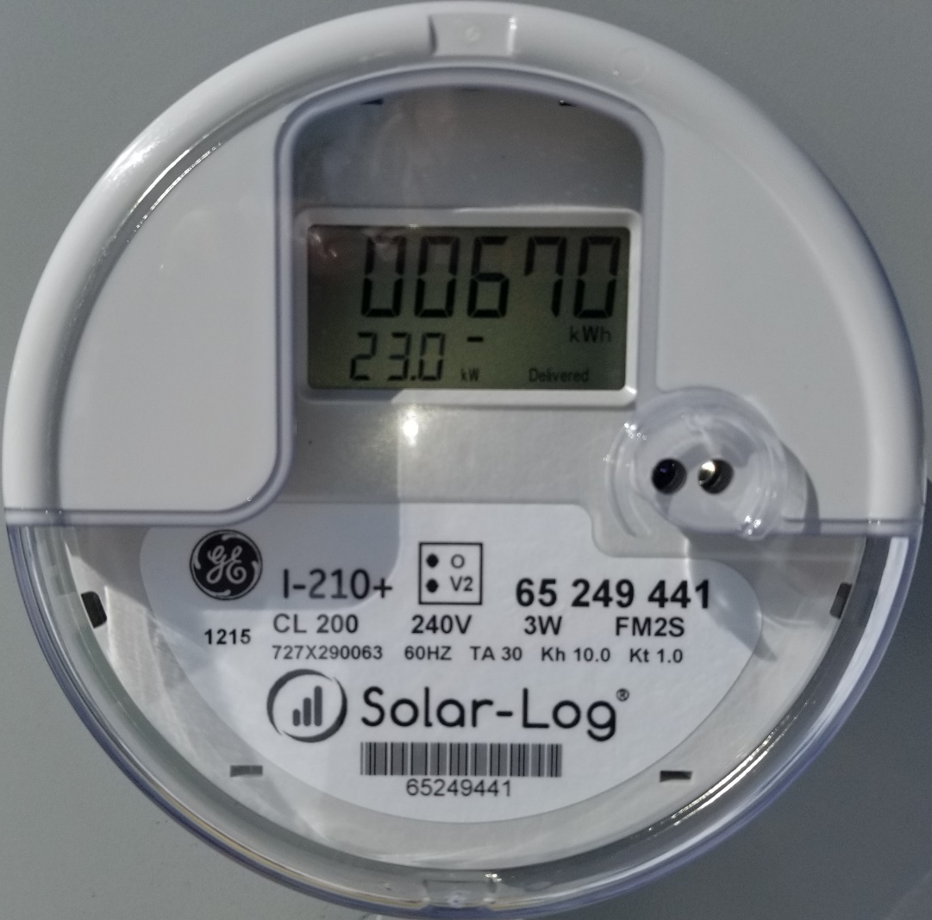
Real-time views of the SolarLog meters
Each solar-log meter (located on the electrical board near the road) displays cumulative kilowatt hours of electricity generated, current power and current grid voltage
Current kW = 23,000 watts of power being produced at that moment.
Voltage also flashes here.
Cumulative kilowatt hours, kWh.
One thousand watts produced for one hour equals one kWh.

Slide 4
Real-time inspection of the inverters
Each inverter (four in all) is rated to produce 11,400 watts of continuous power and 12,000 watts of peak power. Continuous power ratings can often be exceeded for long periods of time on cold sunny days!
Pressing the rubberized green button on the underside of an inverter display activates the display
This reading was obtained on 2/26/2018 around 1:30 PM
Voltage AC and DC
Current power in watts
Number of panels producing power.
36 of 36

Slide 5
Online Monitoring
The SolarLog meters upload production data to the cloud approximately four times per day.
Webster’s weak cellular coverage may yield less frequent updates on occasion, but backlogged data is filled in – never lost.
Dashboard
Daily View
Monthly View

Slide 6
The Dashboard displays power at the time of the last upload, yield history and forecasted weather

Slide 7
The daily view shows the power curve, peak power generated, dips from clouds and total daily kWh produced

Slide 8
The monthly view shows day-by-day production with projected future production based on the forecasted weather.

Slide 9
Thank You! Questions?
Erik Shifflett
Partner
Granite State Solar, LLC
erik@granitestatesolar.com
Office: 603-369-4318

